Slide 1
Printed Circuit Board (PCB) Populating and Soldering
University of St Thomas
Andrew Tubesing

Slide 2
Printed Circuit Board (PCB) Populating and Soldering
University of St Thomas
Andrew Tubesing

Slide 3
PCB Process Outline
General Introduction
Creation/Manufacturing of PCB
Populating the PCB
Soldering
Finishing

Slide 4
PCB Manufacturing

Slide 5
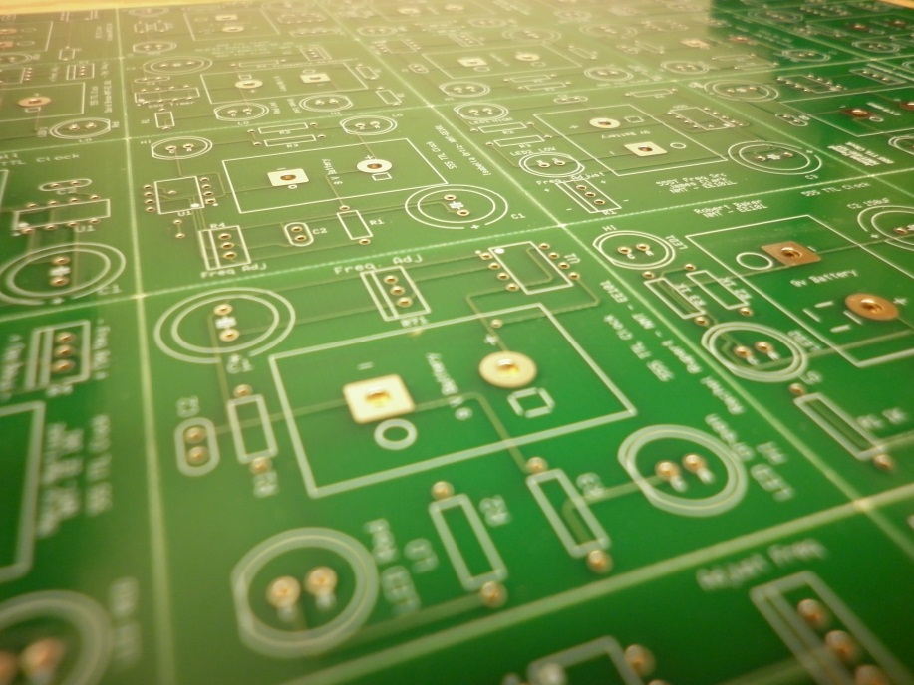
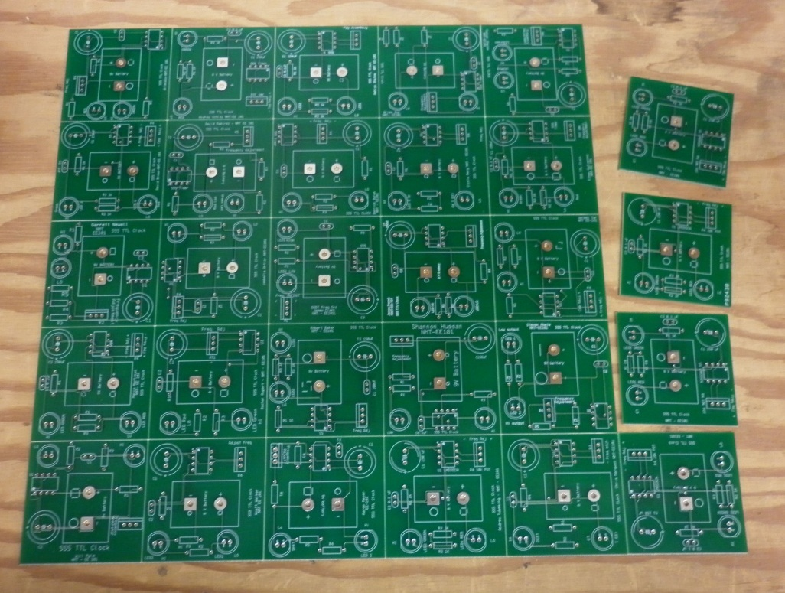
PCB Manufacturing
Tiled Sheet
Separating Boards

Slide 6
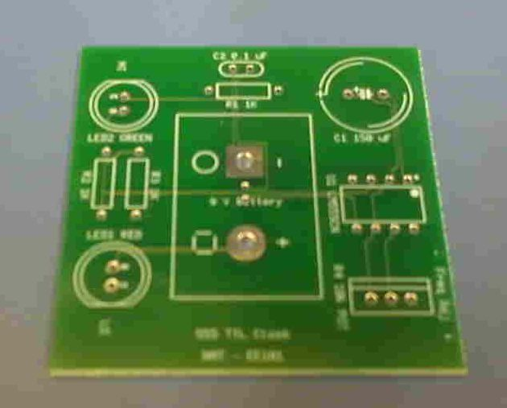
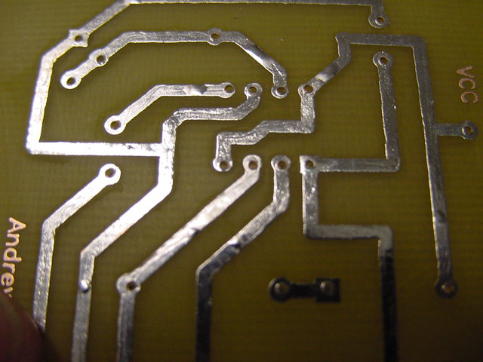
PCB Manufacturing
Commercial
PCB
Hand-made
PCB

Slide 7
Populating the PCB

Slide 8
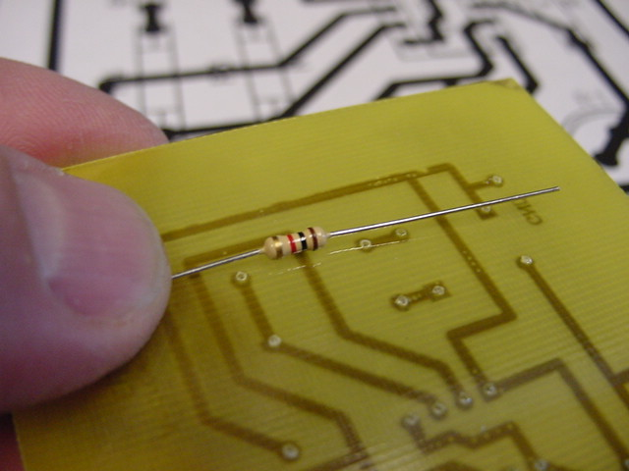
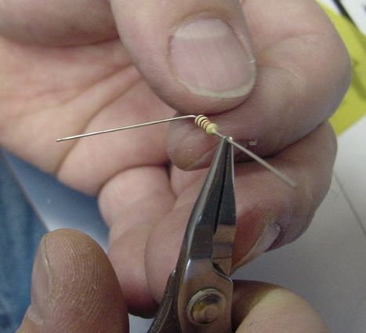
Populating the PCB
Use schematic and design printout to determine where the part belongs
Lay part across footprint and note where bends are needed
Use needle-nose pliers to make right-angle bends

Slide 9
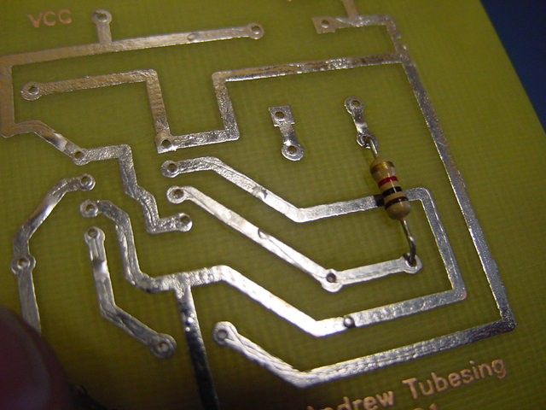
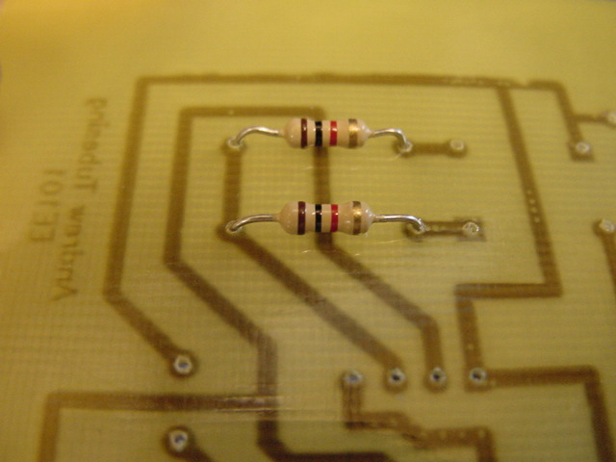
Populating the PCB
Be sure to place parts on proper side of board
This is the wrong side
This is the correct side (commercial PCBs will have labels on the component side)
Note how bends impact tidiness

Slide 10
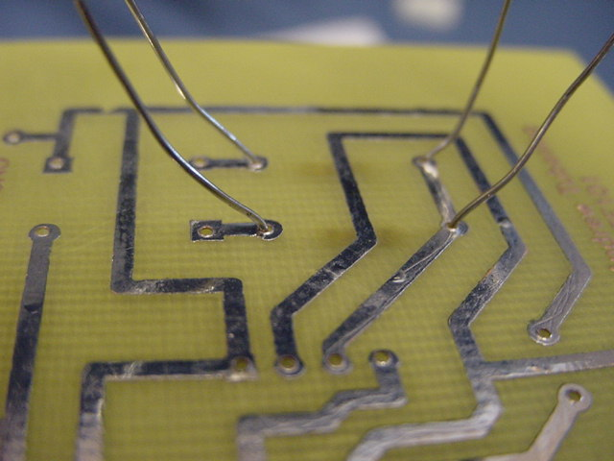
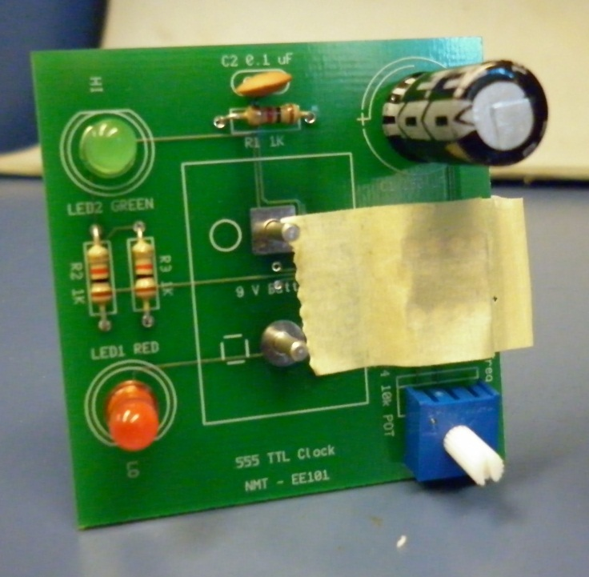
Populating the PCB
Bend leads away from each other to hold components in
Do not flatten onto board surface
Components with short or thick leads can be taped on the top side
Note silkscreen layer labels on commercial PCB

Slide 11
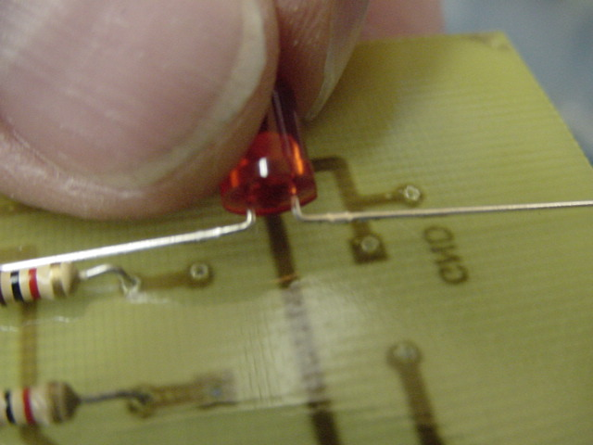
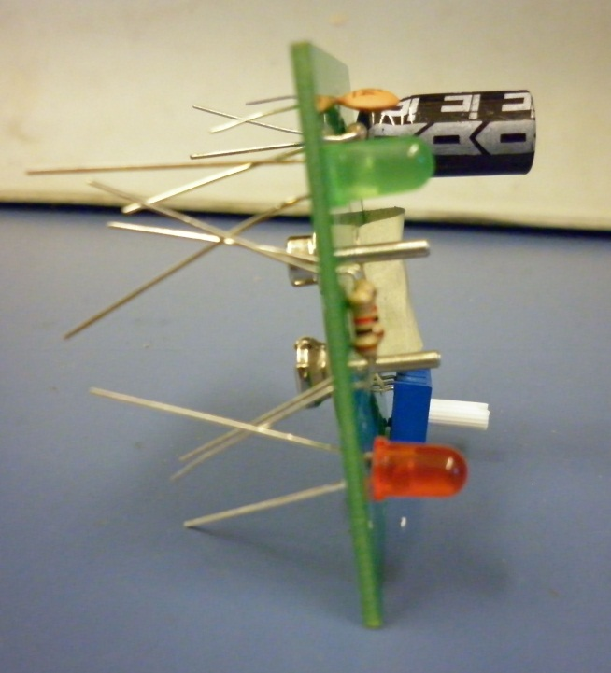
Populating the PCB
Some components may need footprint adaptations
Best to fix this in design stage, not production stage
Fully populated PCB
Note potentiometer and other parts still need retention

Slide 12
Soldering

Slide 13

Soldering
Safety First!
Hot Molten Metal!
Pb & J
Lead + good Judgment = ☺
Wash hands when finished!

Slide 14
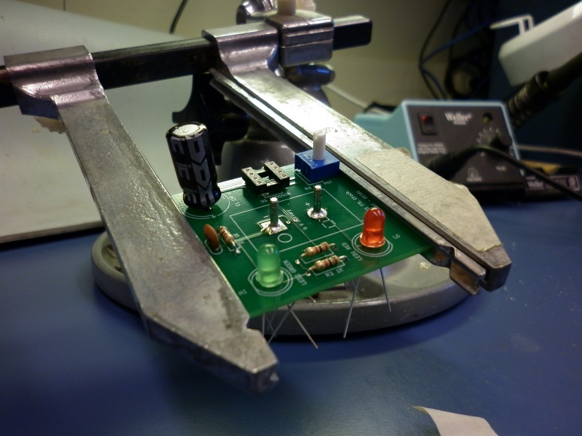
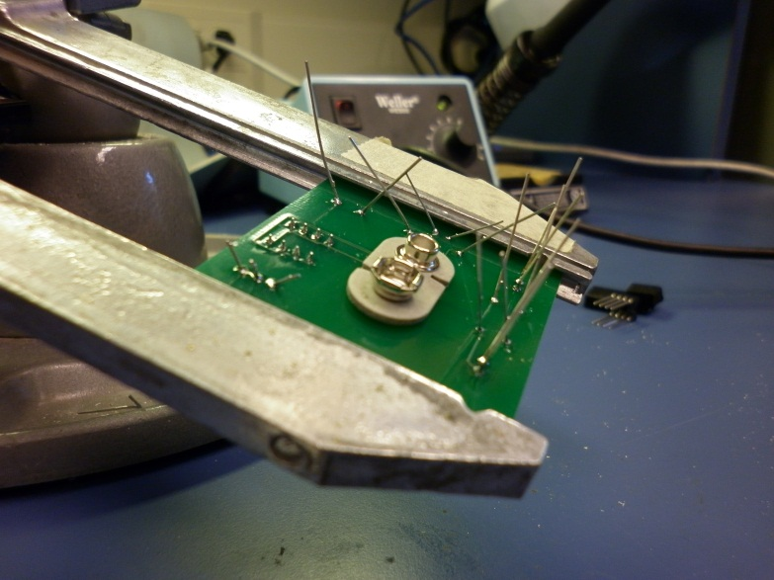
Soldering
Use tools to hold materials
Vice/clamp stand also makes good wrist support
Face bottom side up for soldering

Slide 15
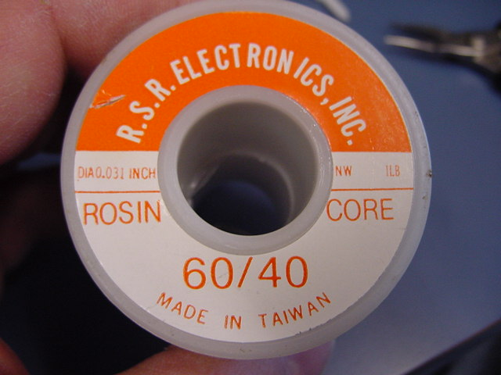
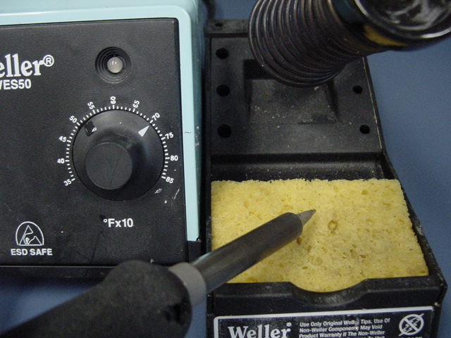
Soldering
Solder is ~half tin and ~half lead
Rosin core provides flux as you solder
Preheat iron
~700° F ~ 475 ° C
Clean tip periodically
Removes stray solder & burned flux

Slide 16
Soldering
Heat is the critical component
All parts (pad & wire) must reach solder melting temperature
It’s all about heat transfer
Solder ≠ Hot glue !
Think of it as the catalyst to bond the metals together
HEAT

Slide 17
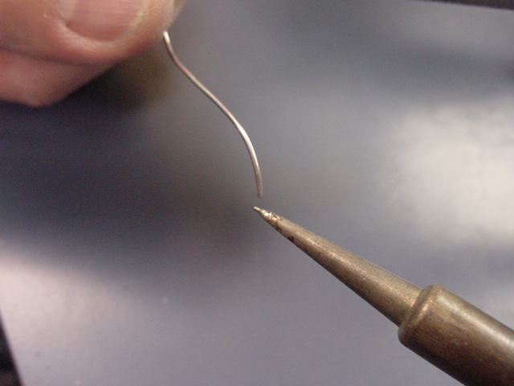
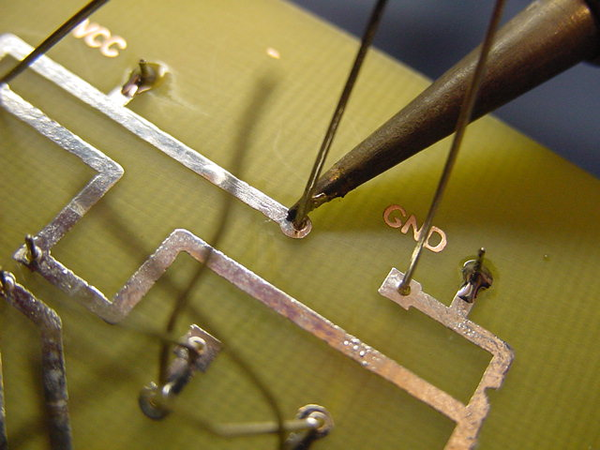
Soldering
Start with a small amount of solder on the iron tip
This helps maximize heat transfer from iron to parts
Place iron tip so it contacts both the solder pad and the component lead
Wait for parts to heat

Slide 18
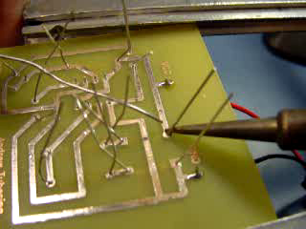
Soldering
When parts are hot, add solder
Do not heat too long or multiple times
Touch solder to PARTS (not iron)
Solder won’t melt until parts reach critical temp. ☺
Melting directly to tip increases chances of cold solder joint ☹
After solder is applied, wait a few seconds to equalize heat
Pull iron away (best to slide it up the lead)
Allow parts to cool

Slide 19
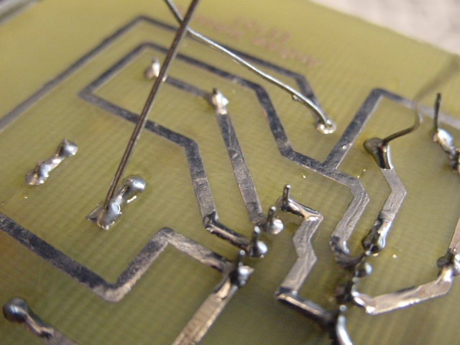
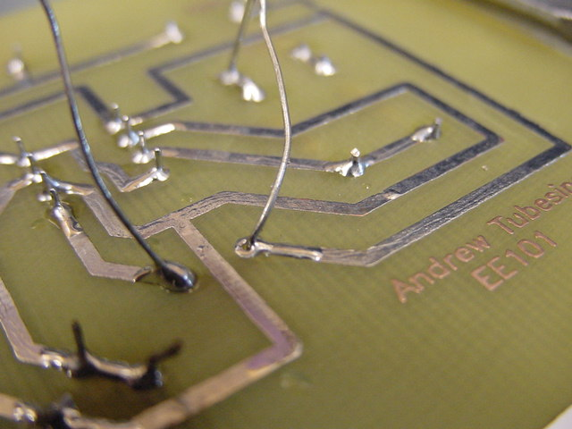
Soldering
GOOD solder joints:
Full lead and pad coverage
Miniscus/wicking
Shiny and uniform
Re-touch solder joints only when absolutely necessary
Re-touching requires reheating the entire joint, including materials
Re-heating damages metallurgical bond

Slide 20
Soldering
BAD solder joints:
Incomplete coverage
Pitted, Frosty or non-uniform texture
Bulbous blobs
Scorched substrate
Causes
Solder quantity +/-
Too little heat (cold joints)
Too much heat (temp/duration)
Multiple re-heats (retouching)

Slide 21
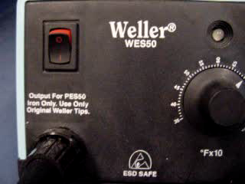
Soldering
Not quite done yet…
Turn off iron:
Whenever you finish a stage
Any time you get out of your seat
It doesn’t take long to re-heat
Avoids fire hazard
Conserves energy
Prolongs tip life

Slide 22
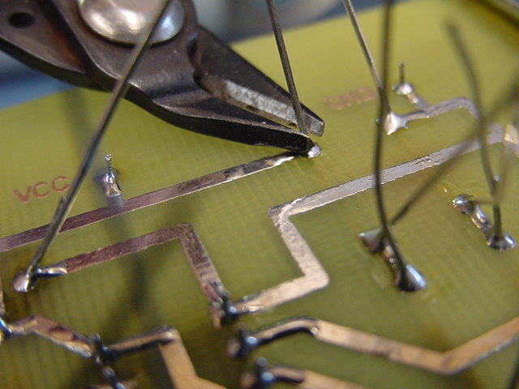
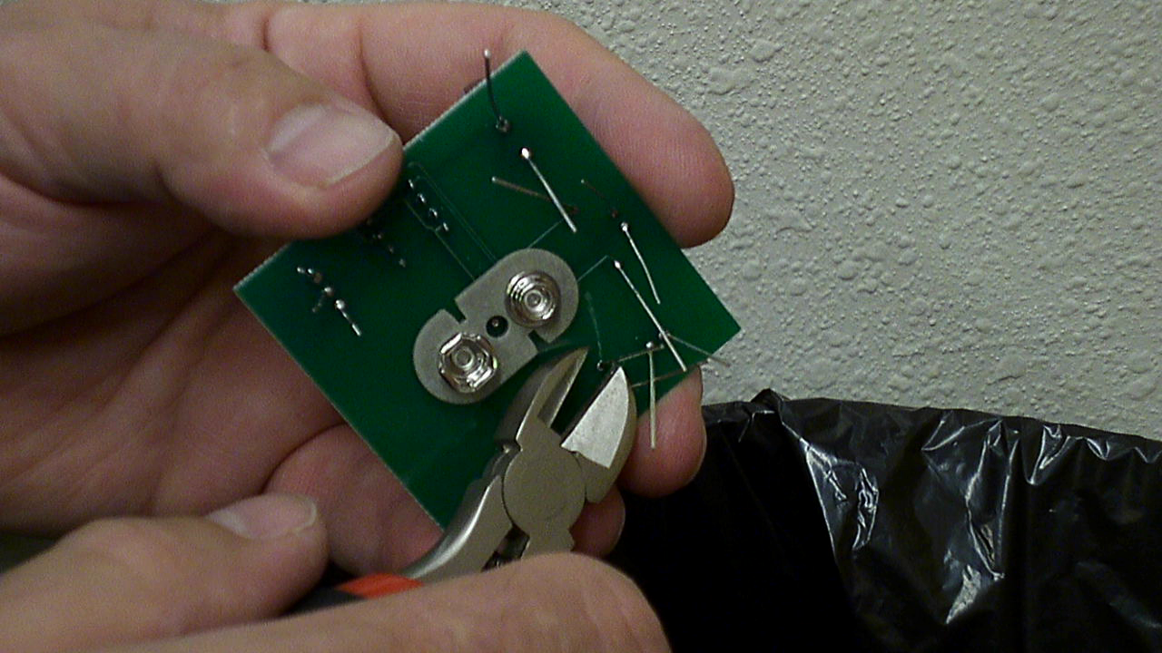
Finishing
Trim leads
Just above solder
Don’t cut into solder
Leave minimal protrusion
Safety first
Still wearing eye protection, right?
Point away from others in room (rockets!)
Aim into trash
Clean up after yourself!
Wash your hands!

Slide 23
Summary
heat
Heat
HEAT
HEAT
HEAT!

